Slide 1
Decision Tree

Slide 2
Decision Tree
A decision tree is a supervised learning algorithm used for both classification and regression tasks.
It has a hierarchical tree structure which consists of a root node, branches, internal nodes and leaf nodes.
It works like a flowchart that helps in making step-by-step decisions, where:
Internal nodes represent attribute tests
Branches represent attribute values
Leaf nodes represent final decisions or predictions.

Slide 3
Decision Tree diagram

Slide 4
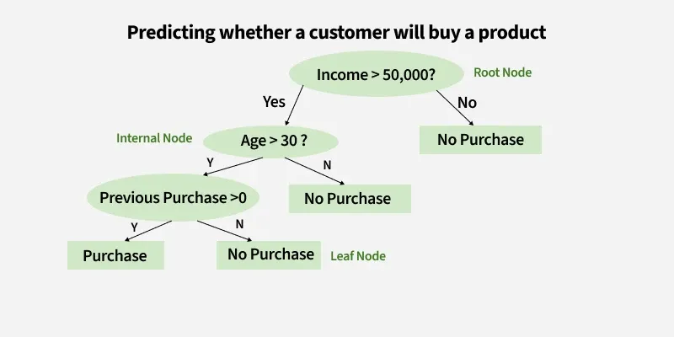

Slide 5
What is Entropy?
Definition: A statistical measure of uncertainty, impurity, disorder or mixed classes in a node.
Scale: Ranges from 0 to 1 (for binary classification).
Low Entropy (close to 0): The data is pure and homogeneous; most items belong to a single class.
High Entropy (close to 1): The data is evenly split between different classes, making prediction hard.

Slide 6
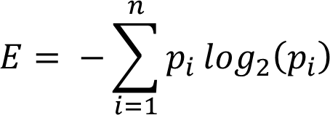
Entropy formula
Entropy is measured by the formula:

Slide 7

Gini Index
The formula is given below:

Slide 8
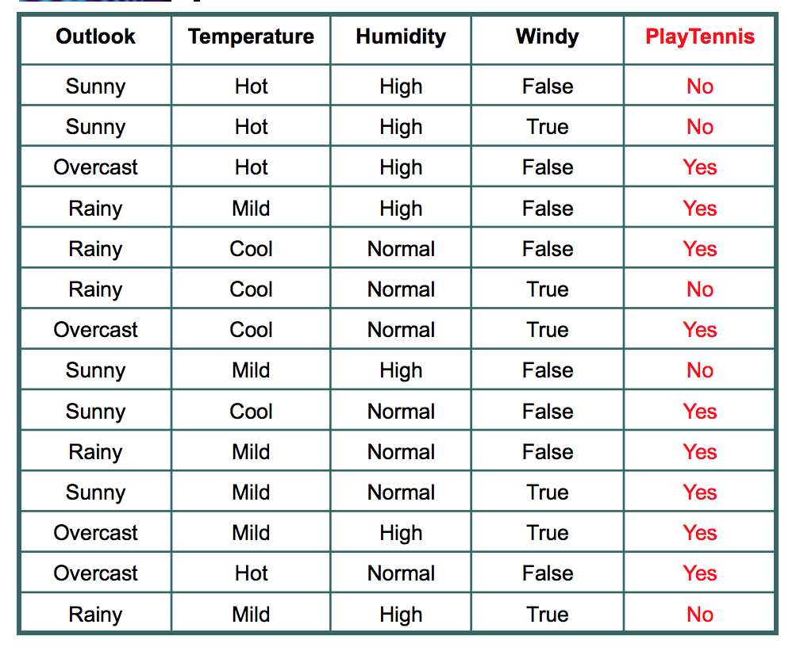
Play tennis

Slide 9
